Slide 1

Project 2: International Alliances and Organizations
Team 9:
Chris Hauck, CollEen Banzhof, Ken Njema, Eric Lewiston

Slide 2
Project Overview
Data
PostgreSQL
Database
Beautiful Soup
Pandas
Web Back-End
SQLAlchemy
Flask
Web Front-End
Leaflet
Apex Charts
D3

Slide 3
Data Scraping
Python Packages:
Requests
BeautifulSoup
Pandas
WorldData.info
31 out of 52 possible Alliances
Visited Each Alliance URL
Wait time is important!

Slide 4

Data Cleaning
Using Pandas:
Removed units from columns
Re-typed number columns as int/float
Formatted data as our PostgreSQL DB expected the data
3 Different csv files

Slide 5
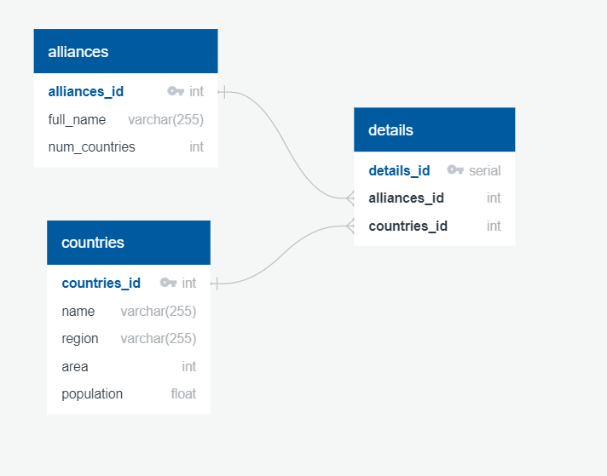
Database Design _____________
We chose PostgreSQL database for its reliability on relational Open Source databases.
Scraped data was grouped into three csv files i.e. Alliances, Countries & Details.
Then we created a World Alliance database and populated the three respective tables above with the data.

Slide 6

Flask Server
SQLAlchemy to connect to PostgreSQL database
Populate values and JS vars with Jinja2 templating
Utilized a single Endpoint for the 3 Views.

Slide 7
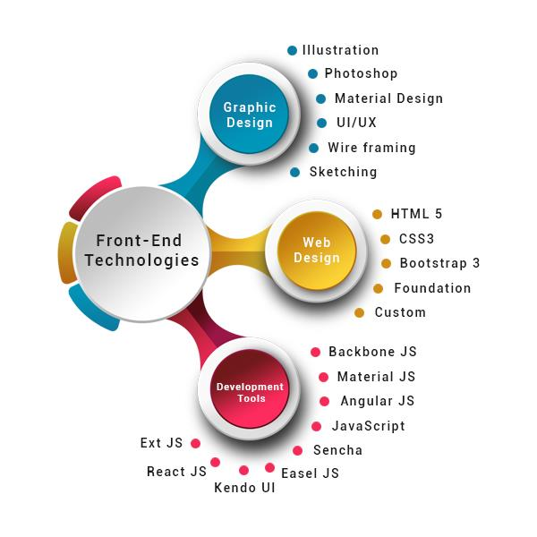
Front End Technologies
The Web browser was created using
the three main front-end coding languages.
HTML,
CSS and
JavaScript.

Slide 8
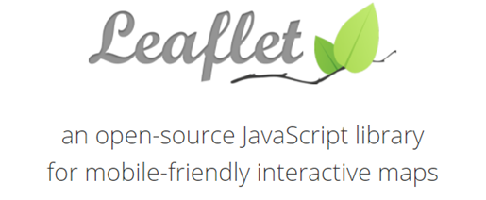
LEaflet
For the map, we used Leaflet to create
an interactive map visualization that
plots the member countries by
International Organization

Slide 9
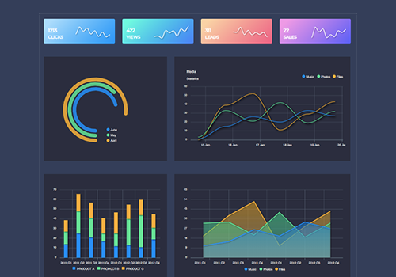
ApexCharts
For the extra Js library, we used the
ApexCharts.Js charting library to create
an interactive visualizations the web page.

